Slide 1

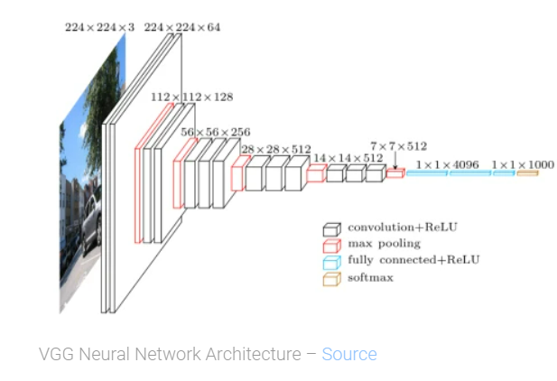
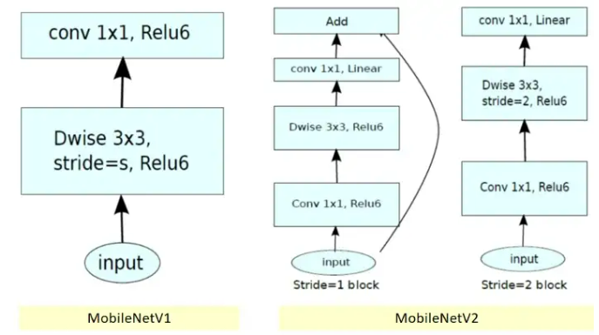
Dayananda Sagar College of Engineering Department of Computer Science & Engineering
Citrus Fruits and Leaves diseases detection using Deep Neural Network model BATCH NO – 3: ADITI ANAND HURALIKOPPI(1DS19CS010), GUDURU RAMA KOUSHIKA(1DS19CS054), KOPPALA JYOSHNA(1DS19CS072), KUNCHE NITHYASREE ROYAL(1DS19CS075) Guide: Dr. C.Vinothini – Associate Professor
Problem Statement:
Citrus Fruits and Leaves Diseases Detection using Deep Neural Network Model.
Abstract
Objectives
Methodology
Expected Outcome/Results
In Agriculture, decline in the yield of citrus fruits is mainly caused by diseases occurring in citrus fruits and leaves. Early detection of diseases involves usage of deep learning strategies by designing an automated detection system with a convolutional neural network (CNN) model. The diseased citrus fruits and leaves of Canker, Greening, Melanose, Black Spot and Scab are separated from healthy leaves by combining and fusing several layers. The main purpose is to build a model which identifies the disease and allocates the corresponding disease class to the image. Deep learning classifiers uses a large number of layers with optimal parameter set.
The objectives of this project are:
To identify the diseases in the citrus fruits and leaves using the deep neural network model
.Differentiating the healthy citrus fruits and leaves from the unhealthy fruits/leaves.
After detecting the disease in the citrus fruits/leaves, the appropriate fertilizer is suggested.
MobileNet model uses depth wise separable convolutions. It significantly reduces the number of parameters when compared to the network with regular convolutions with the same depth in the nets. A depth wise separable convolution is made from two operations: Depth wise convolution and pointwise convolution. MobileNet model has 27 Convolutions layers which includes 13 depthwise Convolution, 1 Average Pool layer, 1 Fully Connected layer and 1 Softmax Layer. Unit 2:3x3 depthwise convolution is followed by batch normalization and ReLU activation.
VGGNet is a Convolutional Neural Network architecture which mainly focuses on the effect of the convolutional neural network depth on its accuracy. The input to VGG based convNet is a 224*224 RGB image. The input images after pre-processing are passed through these weight layers. The training images are passed through a stack of convolution layers. There are total of 13 convolutional layers and 3 fully connected layers in VGG16 architecture. VGG16 has smaller filters (3*3) with more depth instead of having large filters. Another variation of VGGNet has 19 weight layers consisting of 16 convolutional layers with 3 fully connected layers and same 5 pooling layers
The CNN-based citrus fruits and leaves disease detection model differentiates and identifies healthy citrus fruits & leaves from unhealthy diseased citrus fruits and leaves. Thus, it tackles the problem of disease classification from citrus fruit/leaf images. The layers extract high-level and low-level features help in classifying the images into 5 classes such as Healthy, Greening, Canker, Scab, Blackspot and Melanose. After the disease is detected for citrus fruit & leaf, the fertilizer that can reduce the effect of that particular disease is suggested which is integrated with a web application making it user-friendly.
Applications
Conclusion
Flowchart
Early Disease Detection: Early detection allows farmers to take necessary measures to prevent the spread of the disease and minimize crop loss.
Automated Monitoring & Mobile Applications:Deep neural network models can be integrated with camera systems or drones to monitor citrus orchards continuously. Yield Prediction: By training the model on historical data, including disease incidence and yield records, it can learn the relationship between diseases and the resulting impact on crop productivity.
Disease Classification and Diagnosis
Recommendation for disease management
Healthy and unhealthy citrus fruits and leaves can be distinguished by CNN-based model for fruit/leaf disease identification. After the disease is detected for citrus fruit/leaf, the fertilizer that can reduce the effect of that particular disease is suggested. The main difference between traditional machine learning and deep learning algorithms is in the feature engineering. In traditional machine learning algorithms, we need to hand-craft the features. By contrast, in deep learning algorithms feature engineering is done automatically by the algorithm. Feature engineering is difficult, time-consuming and requires domain expertise. The promise of deep learning algorithms is more accurate compared to traditional machine learning with less or no feature engineering.

